Slide 1
This is around one Standard Drink
How many Standard Drinks did you have this week?
Drinking & Pregnancy
No alcohol in pregnancy is the safest choice for your baby
There is no safe time to drink alcohol during a pregnancy
There is no known safe amount of alcohol to drink during pregnancy.
If you are finding if difficult to cut out alcohol during your pregnancy then talk to your GP or midwife about the support that’s available
NOTE: how one Standard Drink is compared to a typical serving below
Half pint (330 ml) of beer at
4% alc
100ml glass of wine at 12.5% alc
A single 30ml measure of spirits
...and each of these is more than one Standard Drink
1.9
2.3
1.5
1.9
2.5
7
1.3
600ml pint of beer
4% alc
600ml pint of beer
5% alc
335ml bottle of RTD spirit or beer
5% alc
440ml can of beer
4% alc
440ml can of beer
5% alc
250ml glass of wine 12.5% alc
750ml bottle of wine 12% alc
Risk | Men | Women | Common Effects
Lower Risk | No more than 15 S.D. per week on a regular basis | No more than 10 S.D. per week on a regular basis | Increased relaxation Sociability Reduced risk of heart disease (for men over 40 and post menopausal women)
Risky drinking or median AUDIT score | 16 – 40 S.D. per week | 10 - 28 S.D. per week | Progressively increasing risk of: Low energy Memory loss Relationship problems Cancer Depression Insomnia • Impotence Injury • Cardio-vascular disease Alcohol dependence • High blood pressure • Liver disease
Harmful drinking or high AUDIT score | 40+ S.D. per week | 28+ S.D. per week
This tool can be accessed on Health Pathways on the ALCOHOL INTERVENTION MANAGEMENT main page under the link, ‘Brief Advice Tool’

Slide 2
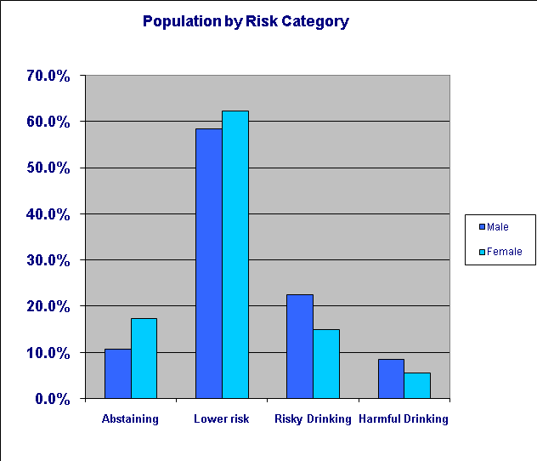
What’s everyone else like?
% of Adult Population
The benefits of cutting down
Psychological/Social/Financial Benefits
Improved mood
Improved relationships
Physical Benefits
Sleep better
More energy
Lose weight
No hangovers
Reduced risk of injury
Improved memory
Reduced risks of drink driving
Save money
Better physical shape
Reduced risk of high blood pressure/CVD
Reduced risk of cancer
Reduced risks of liver disease
Reduced risks of brain damage
Making your plan
When bored or stressed have a workout instead of drinking
Avoid drinking alone
Plan activities and tasks at those times you would usually drink
When you do drink, set yourself a limit and stick to it
Have your first drink after starting to eat
Quench your thirst with non-alcohol drinks before and in-between alcoholic drinks
Avoid drinking in shouts or in large groups
Switch to lower alcohol beers
Avoid or limit the time spent with “heavy” drinking friends
What targets should you aim for?
Men
Should not regularly drink more than 15 Standard Drinks/week
Women
Should not regularly drink more than 10 Standard Drinks/week
‘Regularly’ means drinking every week.
Regardless of how much or little you drink you should have at least 2 alcohol free days per week
What is your personal target?
This brief advice is based on the “How Much Is Too Much?” Simple Structured Advice Intervention Tool, developed at the University of Sydney as part of a W.H.O. collaborative study.

